Slide 1
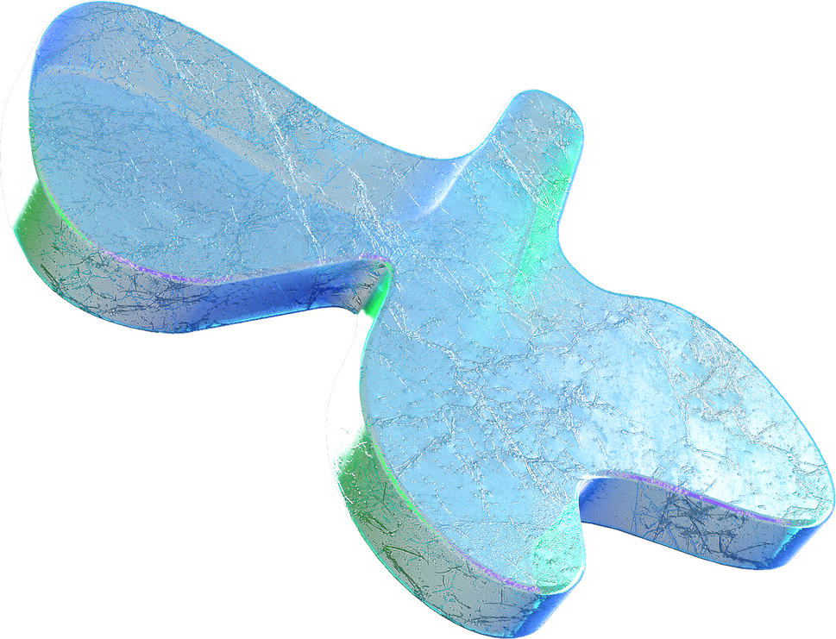
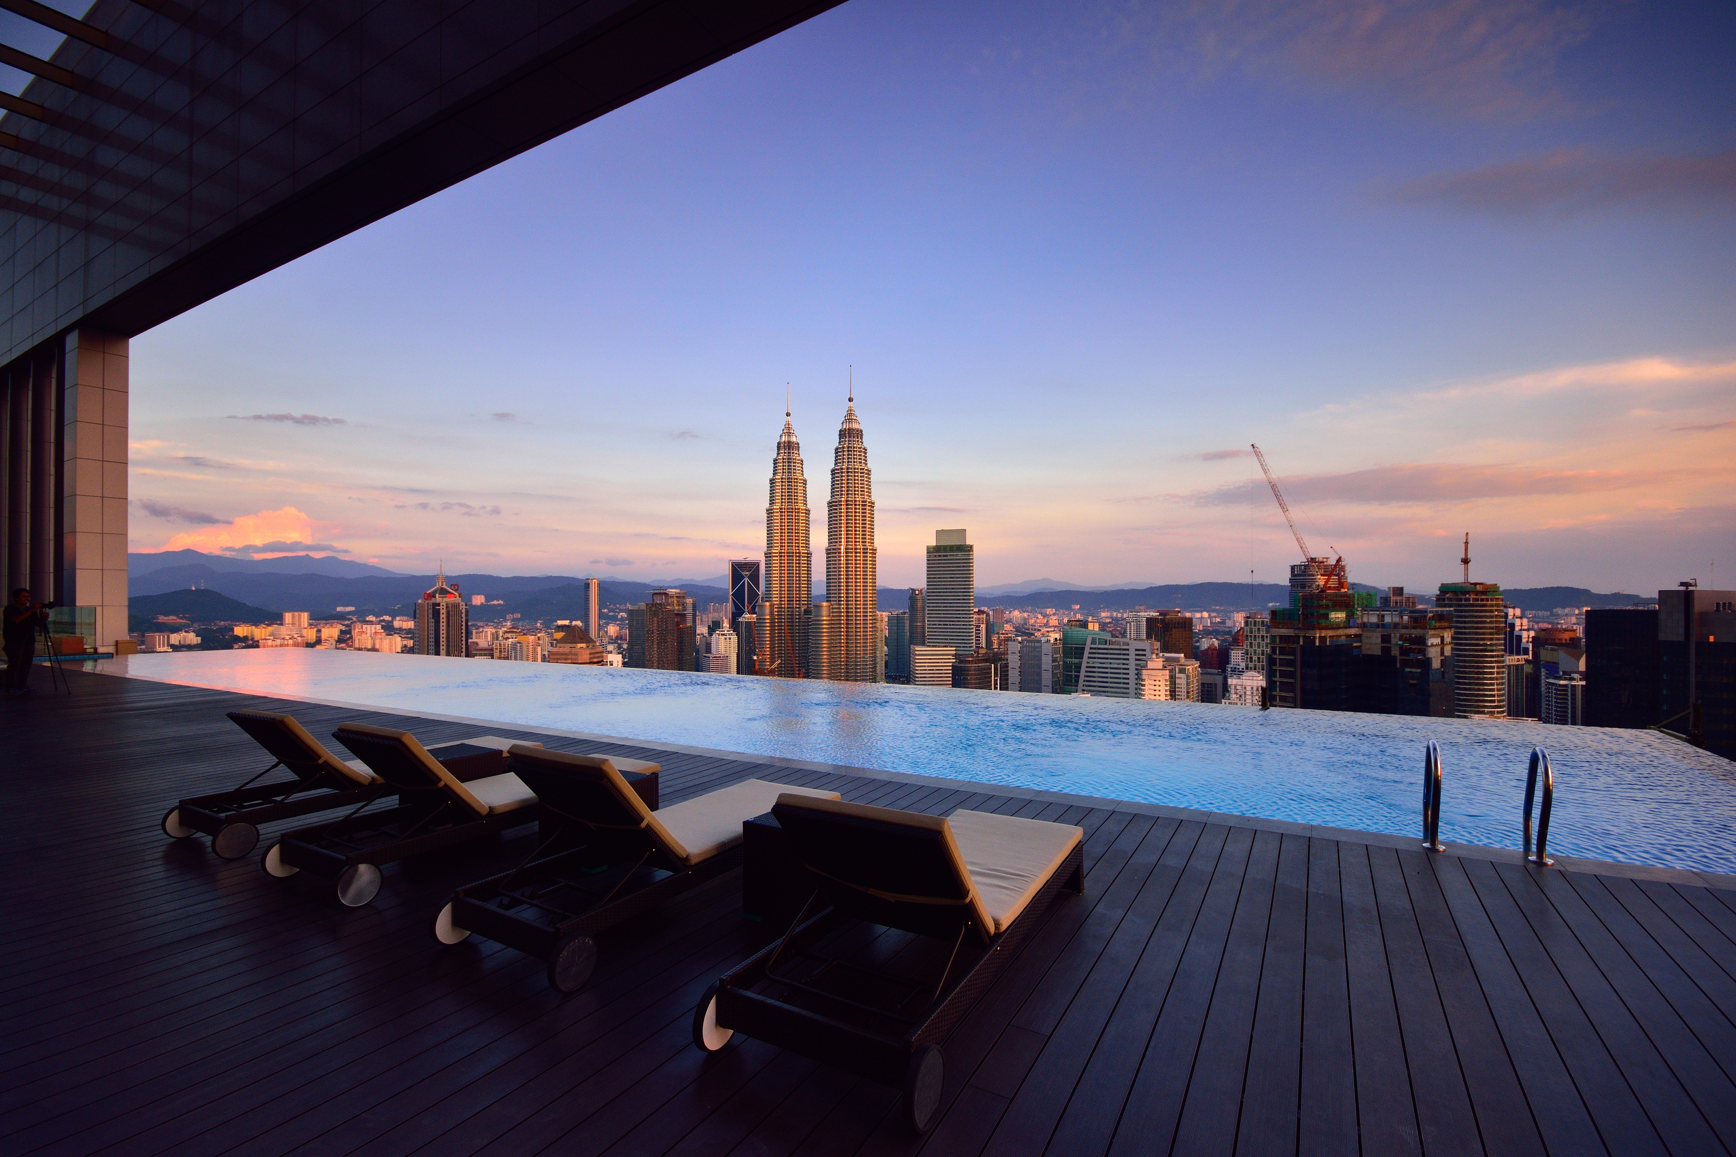
Hotel
Cancellation
Prediction
Presented Group 2
Nov 16, 2024.

Slide 2


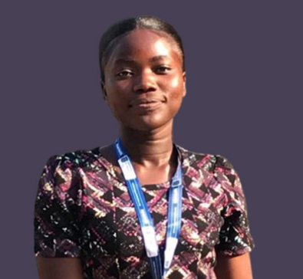

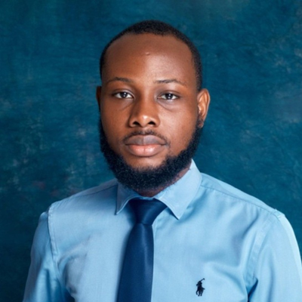
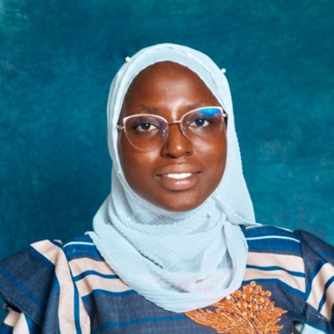
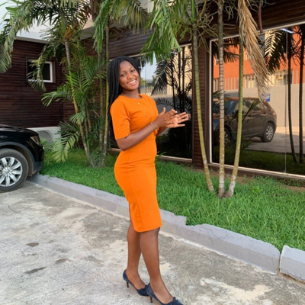

Team
Josephine Cudjoe
Betty Blankson
Napoleon
Quartey-Papafio
Rabiatu Ibrahim
Ellen Essuamah Asante
Susana Ama Gatogo Abban

Slide 3
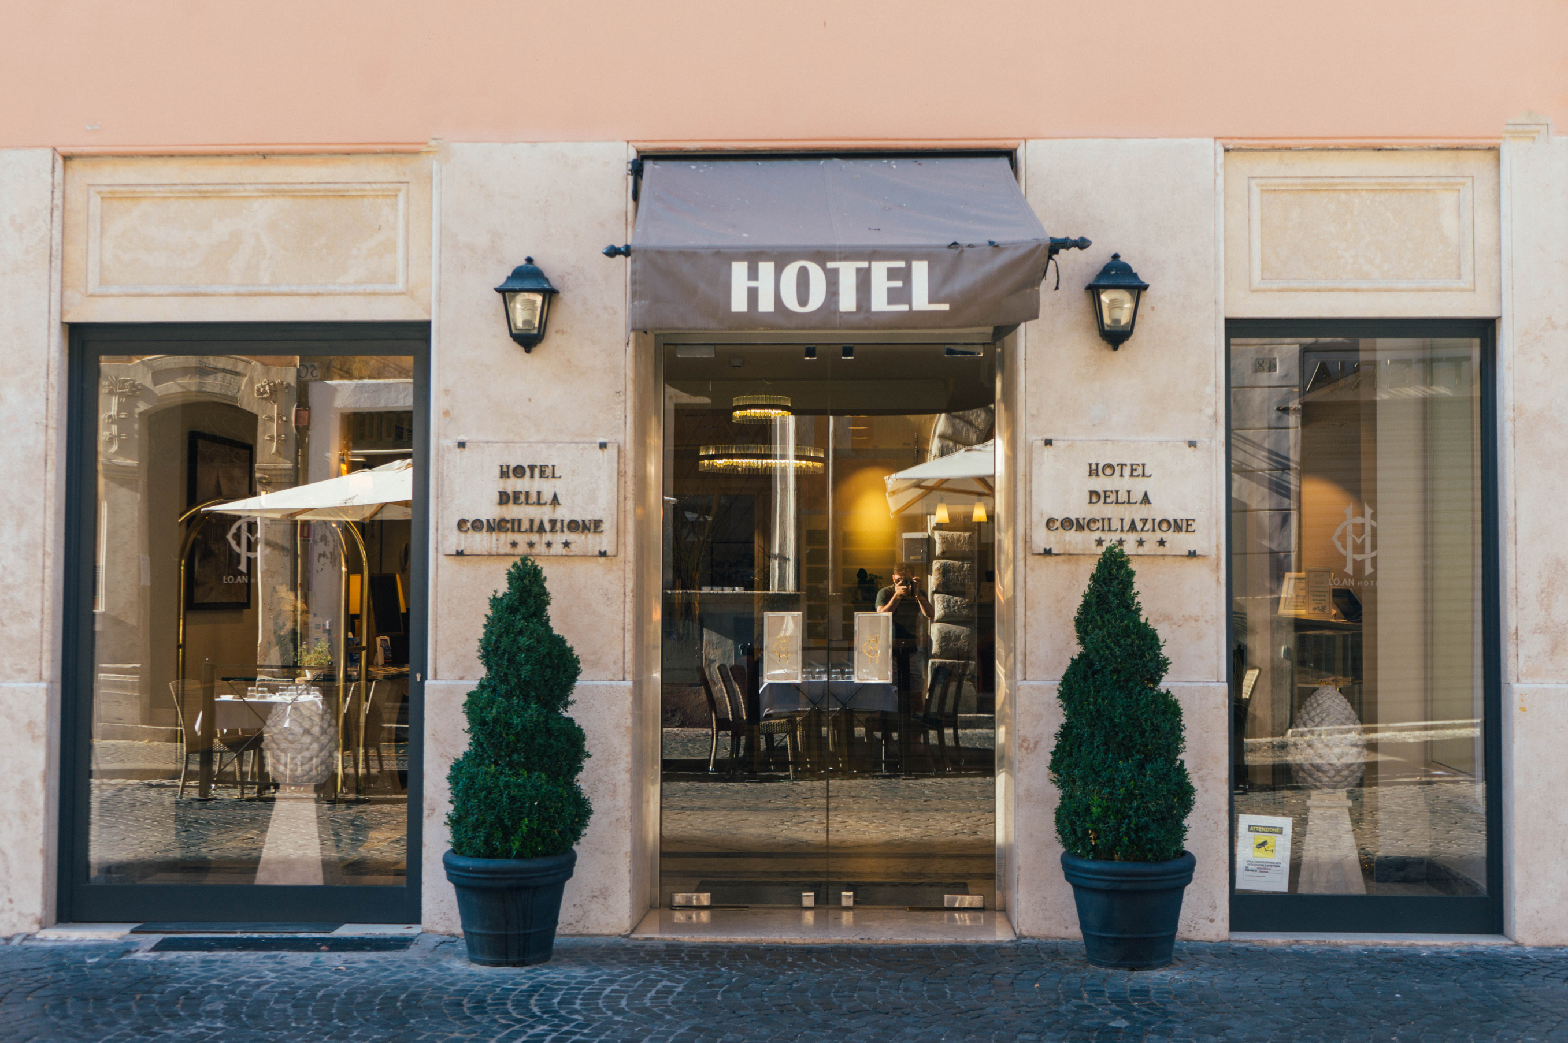
Problem Statement
Luxy Hotels is facing a surge in canceled reservations, resulting in substantial revenue losses. To combat this problem, we propose a machine learning model that predicts cancellations. This model will enable them make targeted retention strategies, reducing cancellations and enhancing customer loyalty.

Slide 4
Aims and Objectives
AIM
To predict whether a customer will cancel a reservation or not.
OBJECTIVES
Explore the dataset
Train machine on classification algorithms on hotel bookings dataset
Evaluate and select best performing model.

Slide 5

How is cancellation changing over time?
What is the distribution of lead times?
How does cancellation rate vary across customer status?
What relationship exists between the numerical features?
Research Questions

Slide 6
Data Overview
Data Info
Rows - 79330
Columns - 32
Duplicates - 25902
Data Features
previous_cancellations(int)
lead_time(int)
booking_changes(int)
is_repeated_guest(cat.)
deposit_type(cat.)
is_canceled (cat.) and 25 other columns.

Slide 7
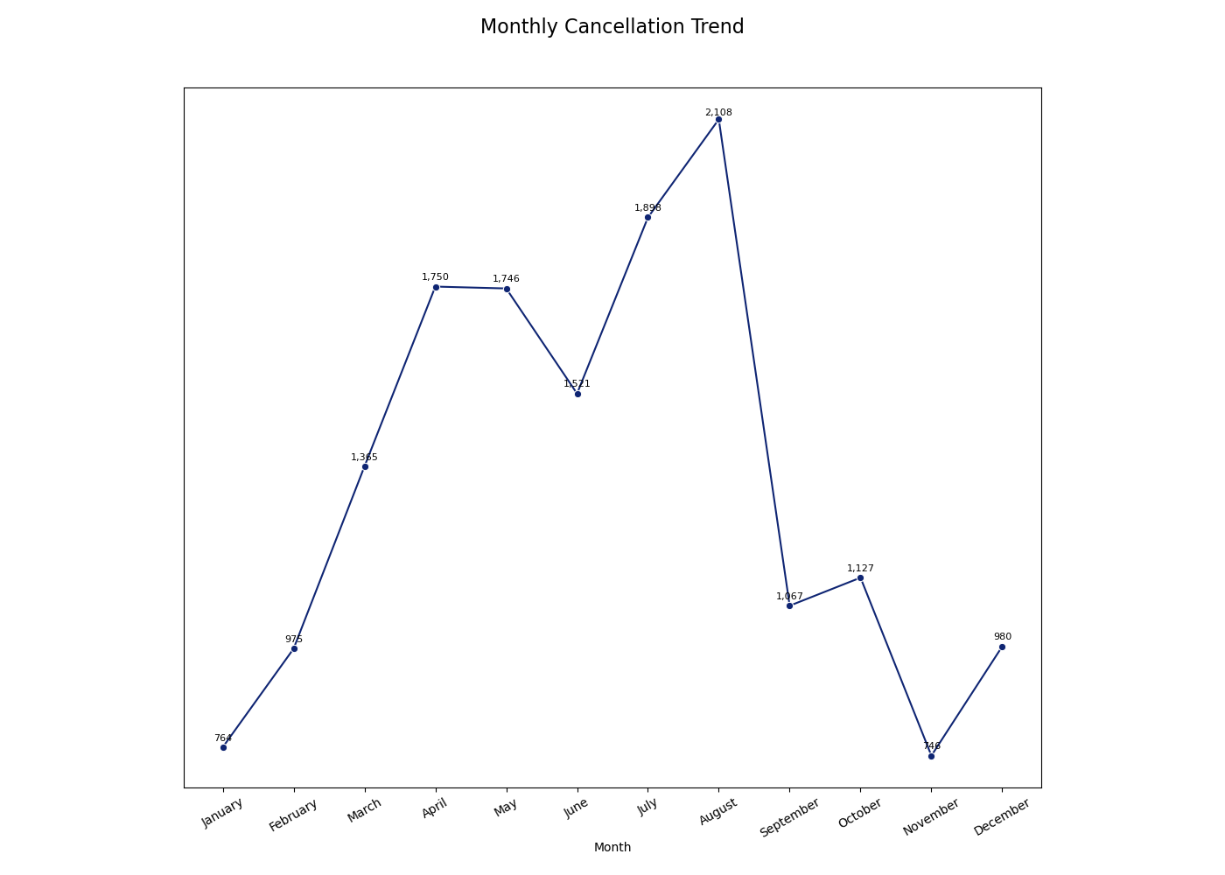
Exploratory Analysis

Slide 8
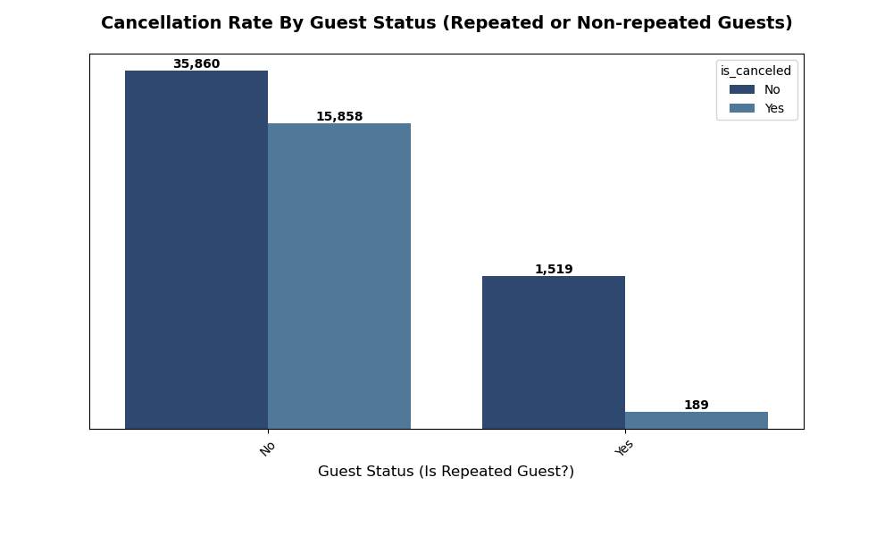
Exploratory Analysis

Slide 9
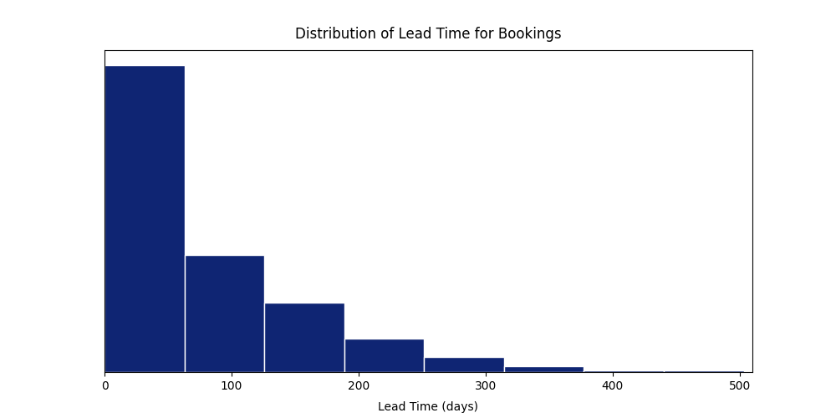
Exploratory Analysis

Slide 10
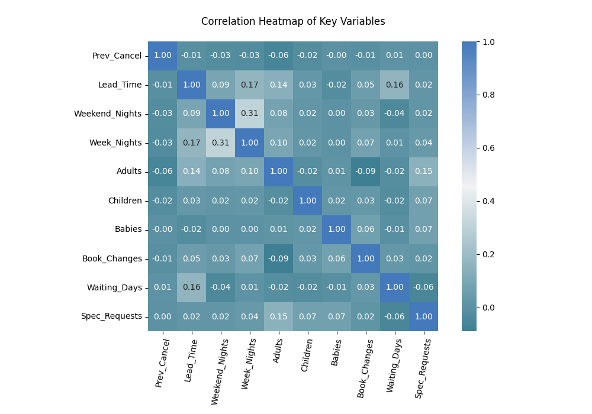
Exploratory Analysis

Slide 11
Machine Learning

Slide 12



METHODOLOGY
Data splitting and Feature selection
Data pre-processing
Model Evaluation
Defined Independent & Dependent
Variables
Hyperparameter Tuning
&
Selection of Best Model.
Model training and testing

Slide 13
Machine Learning Models
Random Forest Model
Logistic Regressor Model
Support Vector Machine
XGradient Boost Classifier
Gradient Boost Classifier

Slide 14
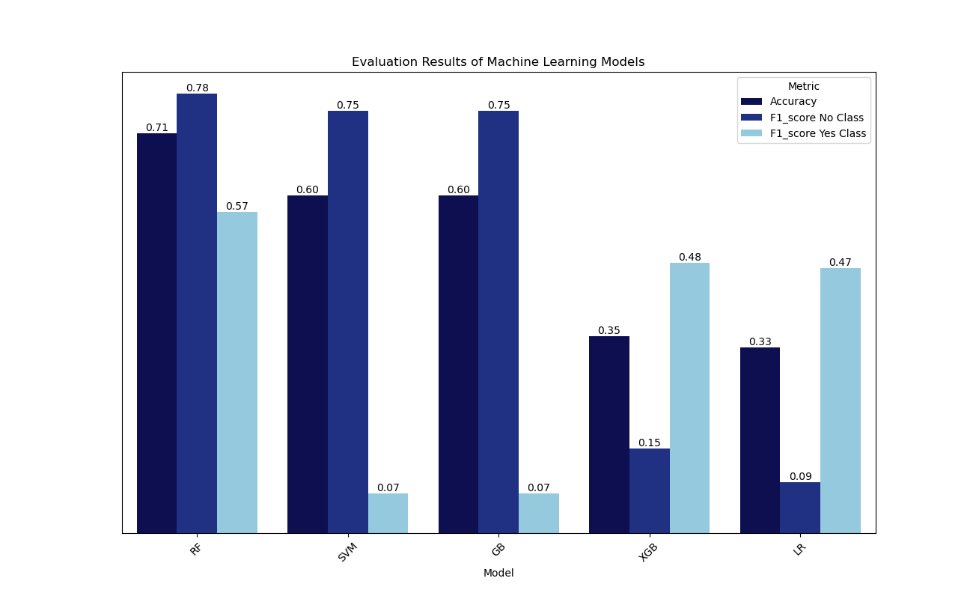
Evaluation Results

Slide 15
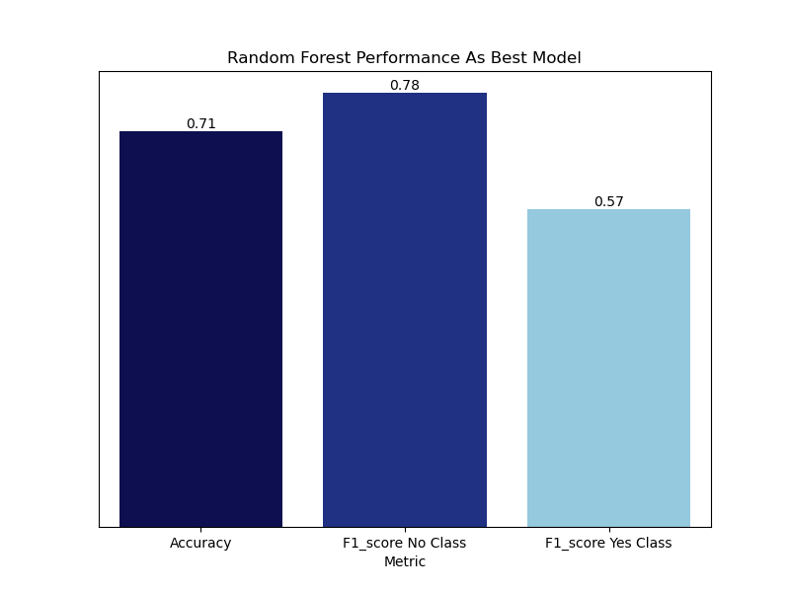
Best Performing Model Results

Slide 16
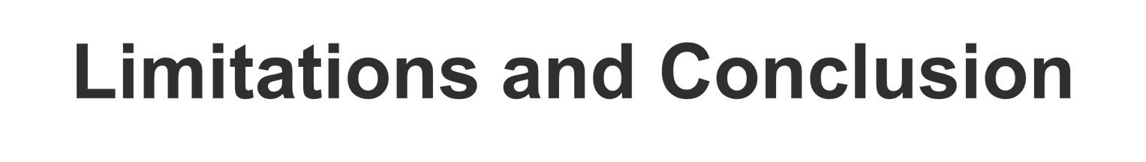
Limitations:
Computational Constraints
Class Imbalance
Conclusion:
With the successful development of our classification model, Luxy Hotels can now identify customers likely to cancel their reservations.
This innovative solution enables targeted interventions to enhance customer satisfaction, driving retention and ultimately, sales growth.

Slide 17
Recommendations
Non-repeated guests have a higher cancellation rate. We recommend targeted promotions to reduce cancellations and encourage loyalty.
70% of customers arrive within 70 days of booking. We recommend the hotel utilize this window to enhance services, boosting customer retention and satisfaction.
Get a robust database and a data analyst to gather their data to avoid missing data and error entries.

Slide 18
References
https://www.kaggle.com/datasets/jessemostipak/hotel-booking-demand

Slide 19

THANK YOU

Slide 20
Do you have
any questions?

